Slide 1
ME528 Control Systems Design
Matthew Robert Norrie – 201934594
Notes:
helo

Slide 2
Part 1 – Approaches
Manual Tweaking
Technology
Trial and error showed PI sufficient.
Tried a lot of settings, logged data.
Investigated Automated gain scheduling – determined out of scope.
Changed input method to ramp.
Set up MATLAB script to cycle through all values for Kp and Ki.
Second script to determine suitable controllers using parameter ranges.
After narrowing down to handful of suitable but still diverse controllers, manually went through and picked.

Slide 3
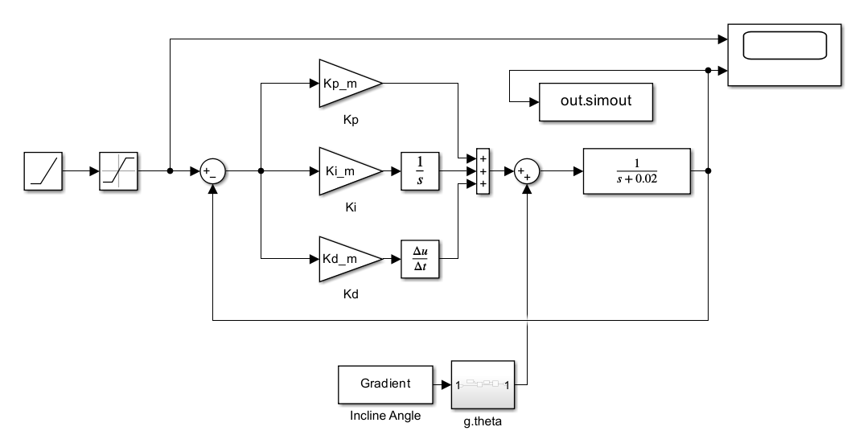

Part 1 – Modelling
Ramp & Saturation velocity input: [+/-] 0 – 60 speed used for gradient.
PID values & Gradient controlled in MATLAB script using iterative process.
Values viewed in Scope & output to MATLAB using out.simout.
Identical control system without MATLAB integration was used for manual iteration.
$$T\left(S\right)=\frac{1.81s+1.47}{s^{2}+1.83s+1.47}$$

Slide 4
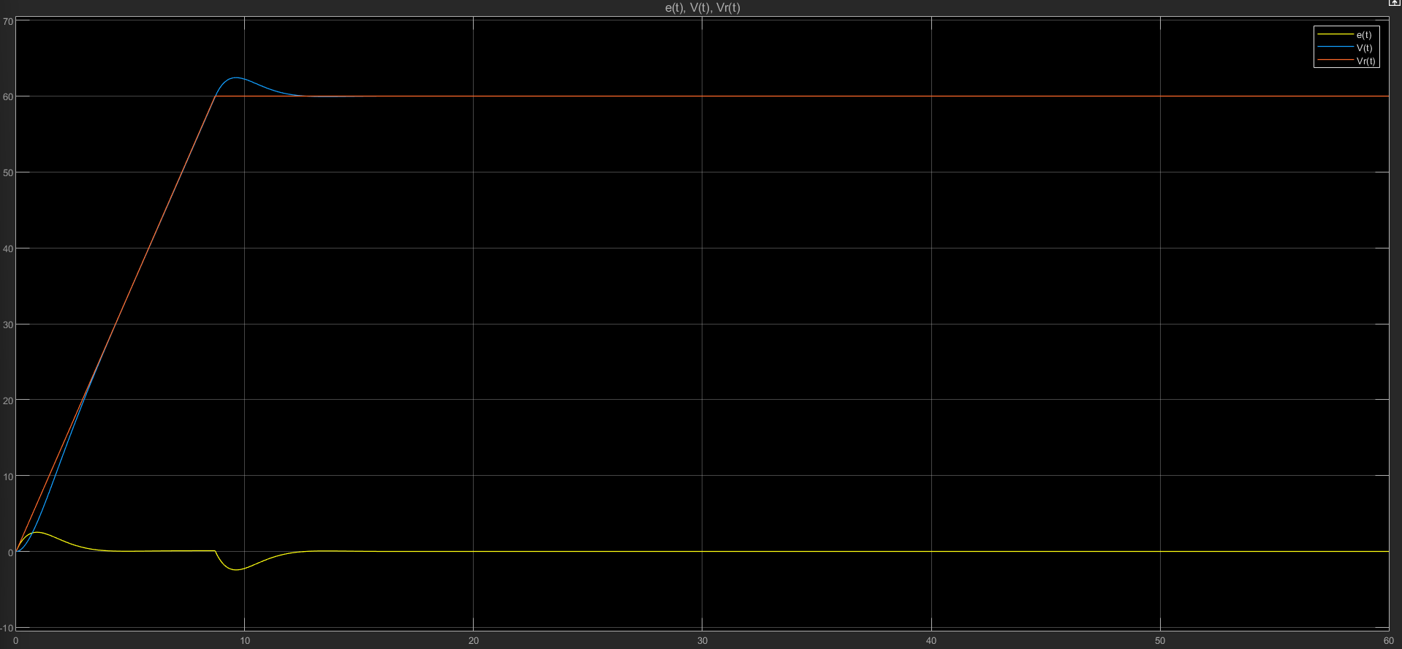
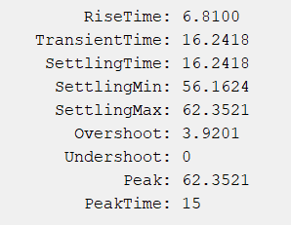
Part 1 - Results
Arrived at Kp = 1.81, Ki = 1.47 for PI values.

Slide 5
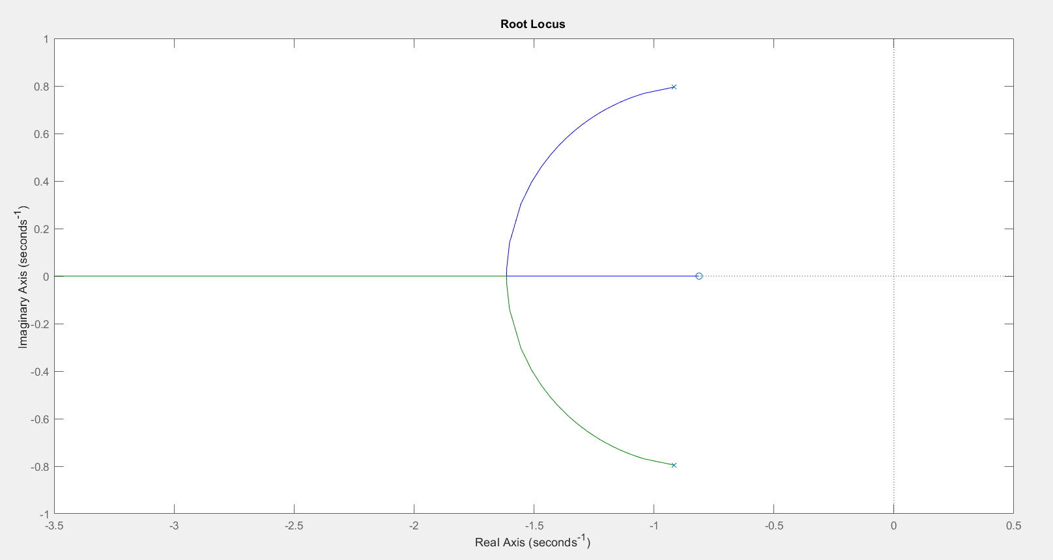
Part 1 – Results
Root Locus Plot:
Notes:
Root Locus has zeros on complex plane, meaning it is underdamped. This correlates with MATLAB’s data of damping ratio equal to 0.75. Poles are on the negative side of the real axis which means the controller is always stable.

Slide 6
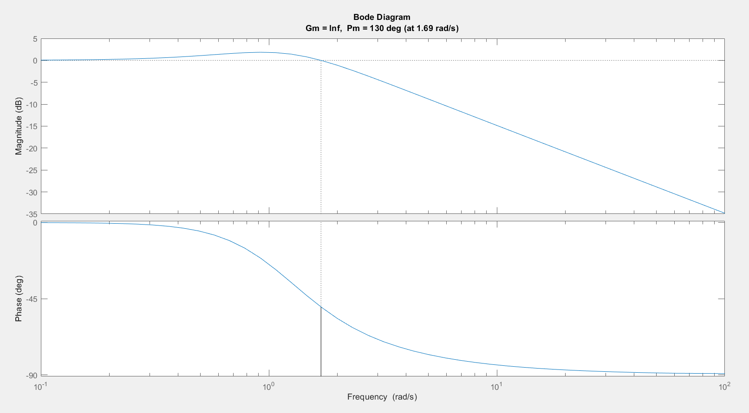
Part 1 – Results
Bode Plot:
Notes:
Infinite gain margin – phase margin never reaches -180 degrees.
Phase margin – 130 degrees. Point at which frequency gain = 0dB. Crossover frequency 1.69 rad/s.
Higher 0dB crossover generally means faster response.

Slide 7
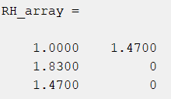
Part 1 – Results
Routh Hurwitz Array:
Kp > -0.02
Ki > 0
Kd > -1
Notes:
All signs the same so stable. Values must stay inside these limits listed to keep the system stable.

Slide 8
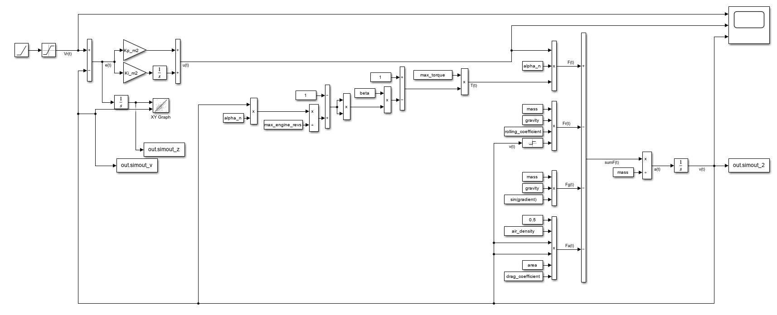
Part 2A – Non-linear Analysis

Slide 9
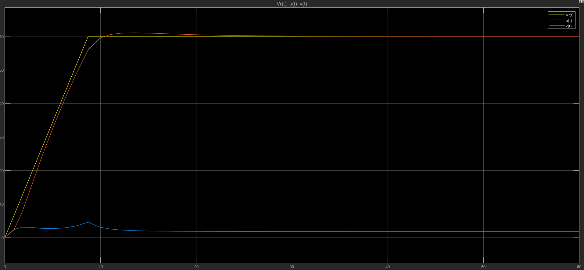
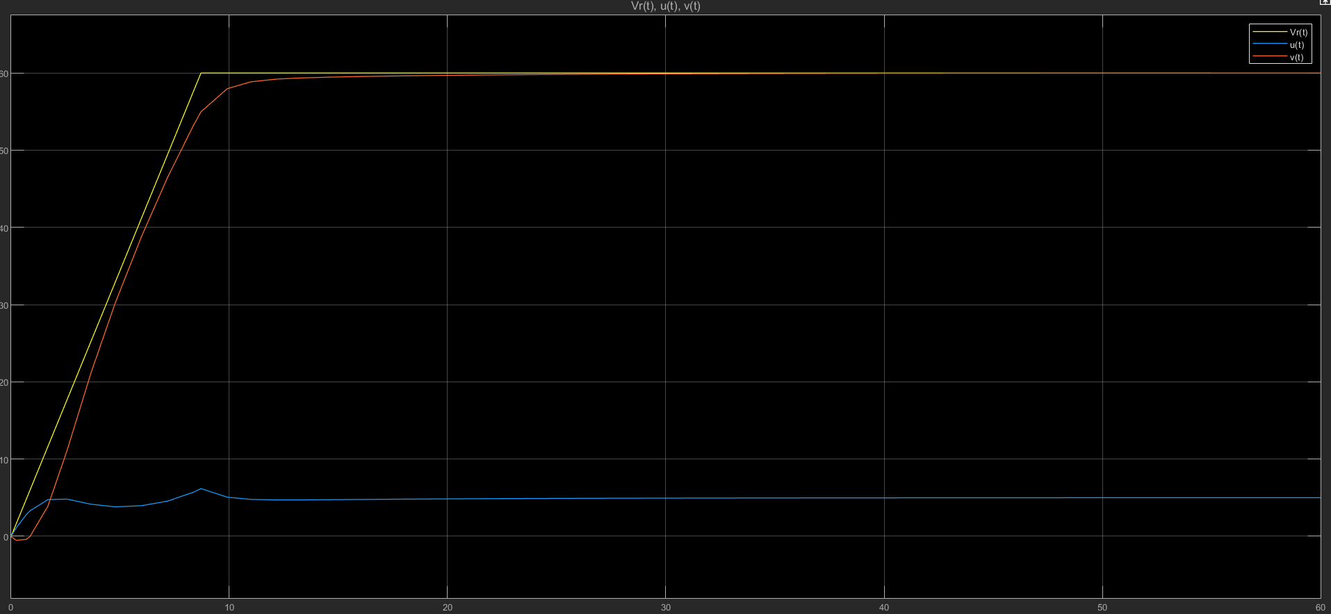
Part 2A – Results:
Both plots 0-60mph
Left plot for flat case.
RIght plot for 20-degree case.

Slide 10
Part 2A – Results
Velocity – Time plot for alpha range:

Slide 11
Part 2A – Results
Z – Time plot for alpha range:

Slide 12
Part 2A - Results
Z – Velocity Phase Space for alpha range:

Slide 13
Part 2A - Cases selected for further study in report
Oscillating inline: 0–20-degree range.
Oscillating speed input: 30-60 mph range.
Combined oscillating speed and incline with same ranges.

Slide 14

Part 2B – Linearisation & Control Torque
$$τ_{c}=m\left[k_{v}\left({\dot{x}}_{sp}−\dot{x}\right)+k_{d}\left(x_{sp}−x\right)+{\ddot{x}}_{sp}\right]+\left[α_{n}\left(k_{p}\left({\dot{x}}_{sp}−\dot{x}\right)+k_{i}\left(x_{sp}−x\right)\right)\left(T_{m}\left(1−β{\left(\frac{α_{n}\dot{x}}{Ω_{m}}−1\right)}^{2}\right)\right)−\frac{1}{2}ρAC_{d}\left|\dot{x}\right|\left|\dot{x}\right|\right]−\left[mgC_{r}sgn\left(\dot{x}\right)+mg\sin\left(θ\right)\right]$$
$$0=\left({\ddot{x}}_{sp}−\ddot{x}\right)+k_{v}\left({\dot{x}}_{sp}−\dot{x}\right)+k_{d}\left(x_{sp}−x\right)$$

Slide 15
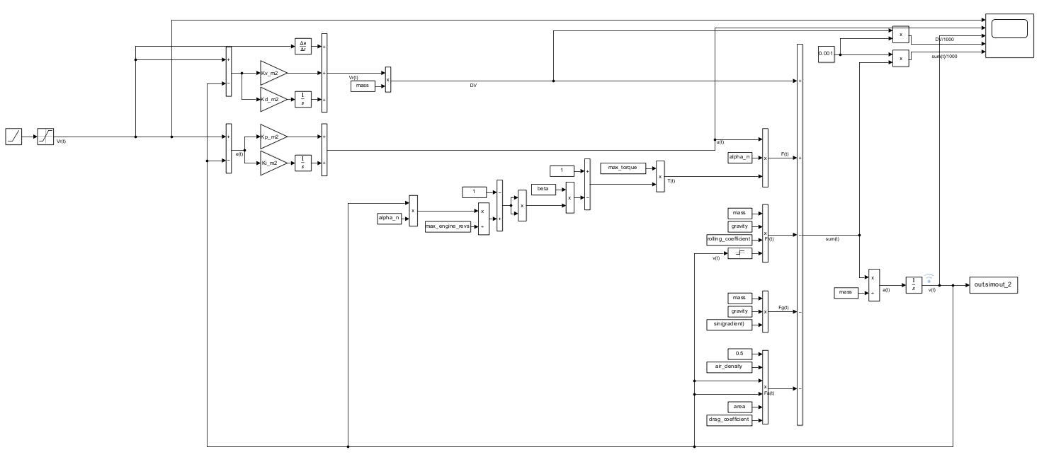
Part 2B – Linearisation & Control Torque

Slide 16
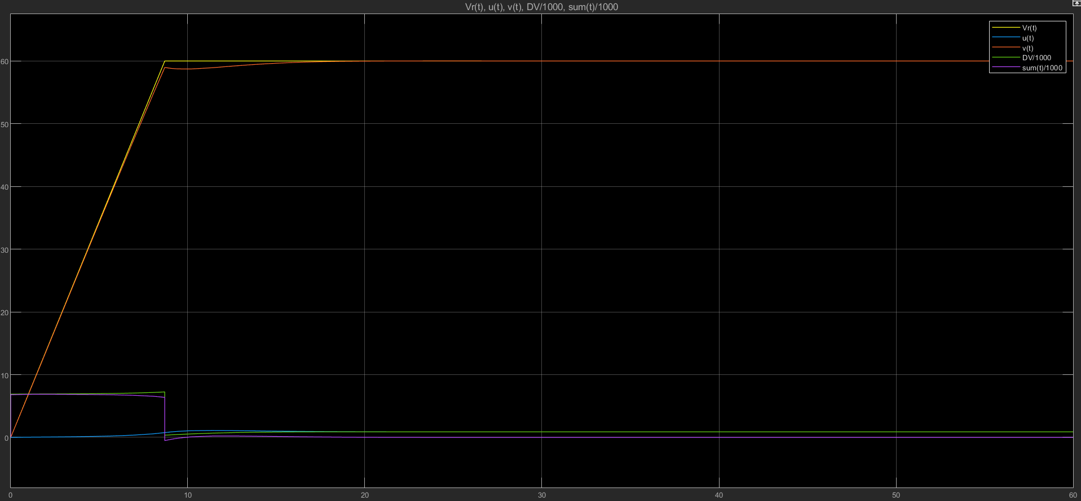
Part 2B - Results

Slide 17
Thank you!
I’m happy to take questions :)

